Slide 1

LSTM on MNIST

Slide 2
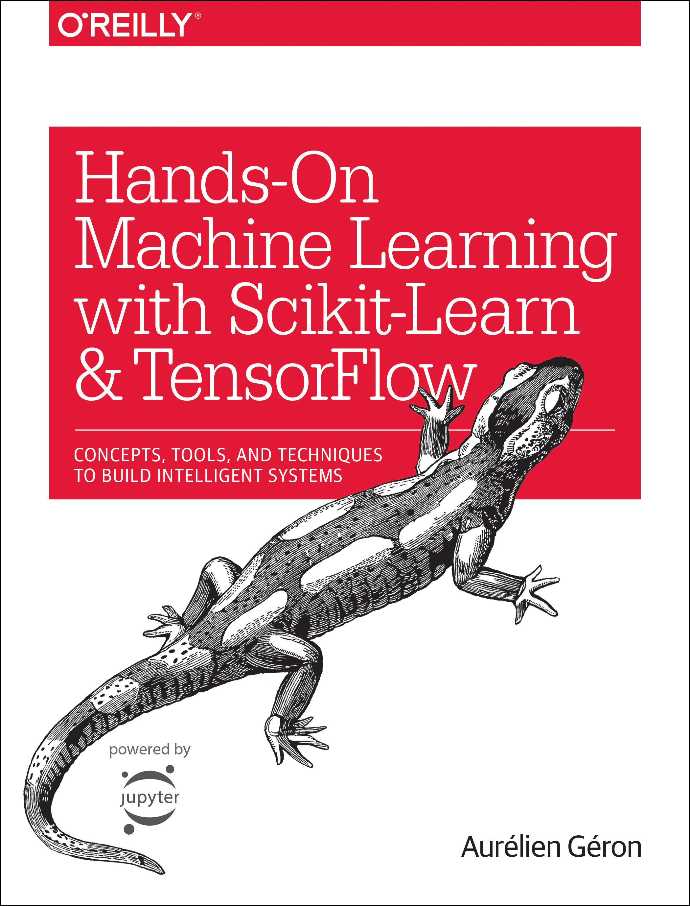
Reference
Chapter 14 (O'Reilly) of Hands-On ML
Youtube on MNIST
Youtube on CNN on MNIST
Youtube on RNN on MNIST
Youtube
Code

Slide 3
Data

Slide 4
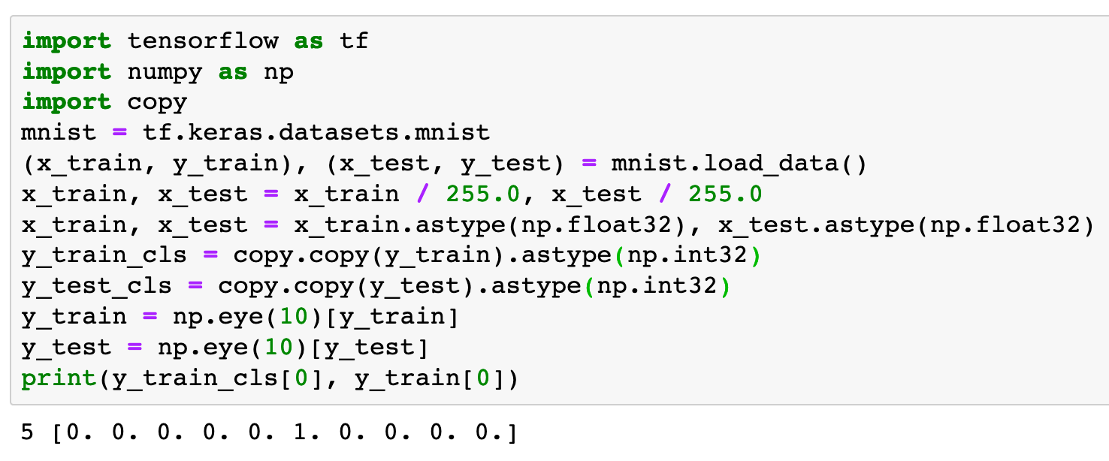

Slide 5
Warm Up

Slide 6
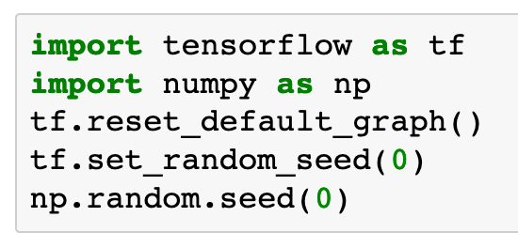

Slide 7
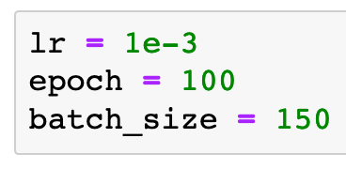

Slide 8
Graph

Slide 9
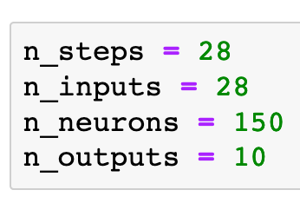

Slide 10
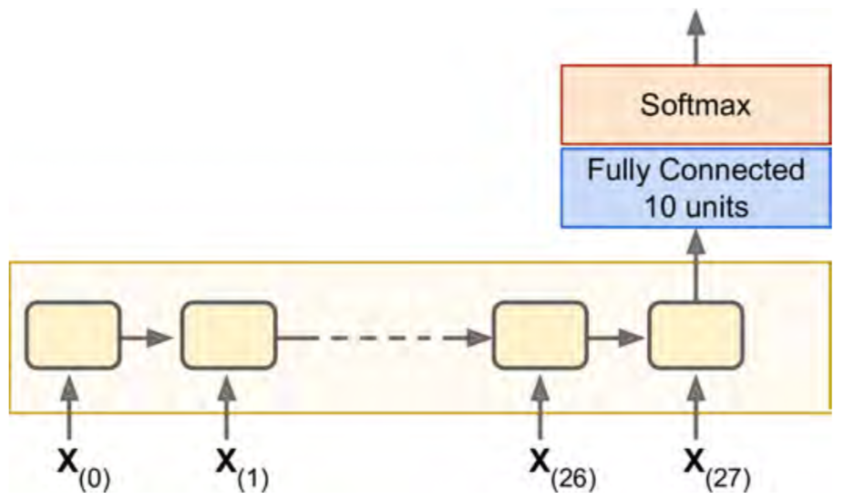
Chapter 14 (O'Reilly) of Hands-On ML

Slide 11


Chapter 14 (O'Reilly) of Hands-On ML

Slide 12

Chapter 14 (O'Reilly) of Hands-On ML

Slide 13
Chapter 14 (O'Reilly) of Hands-On ML

Slide 14
Chapter 14 (O'Reilly) of Hands-On ML

Slide 15

Chapter 14 (O'Reilly) of Hands-On ML

Slide 16
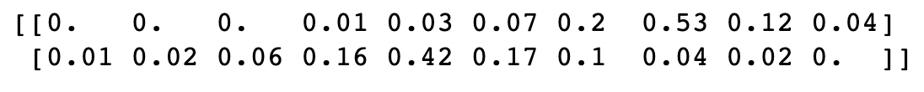
Chapter 14 (O'Reilly) of Hands-On ML

Slide 17
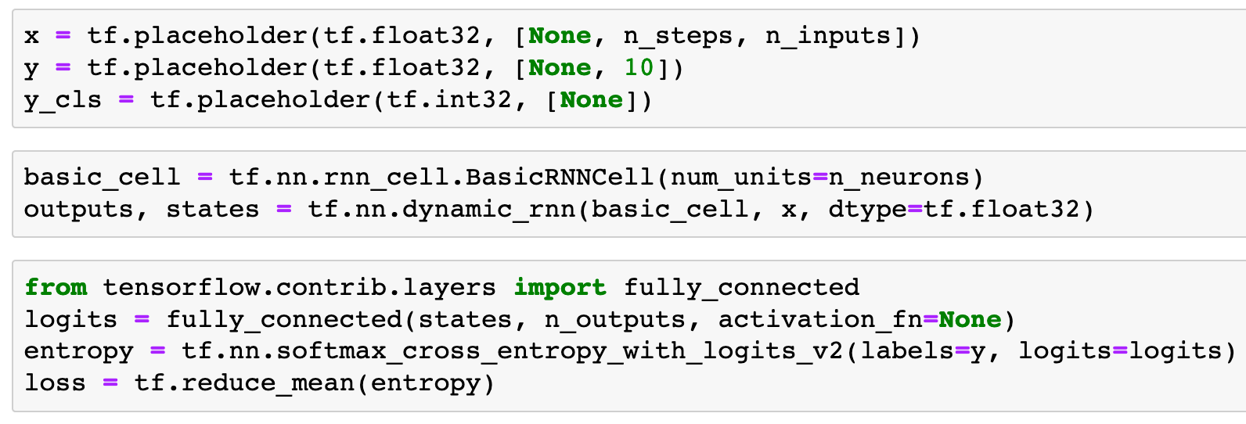
Previously

Slide 18
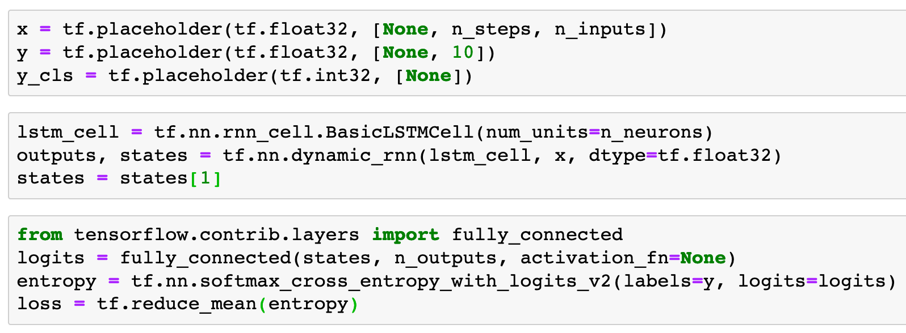
Now

Slide 19
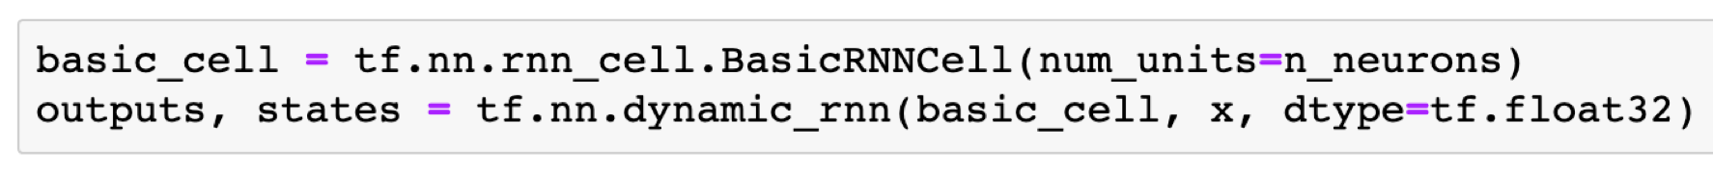
Previously

Slide 20
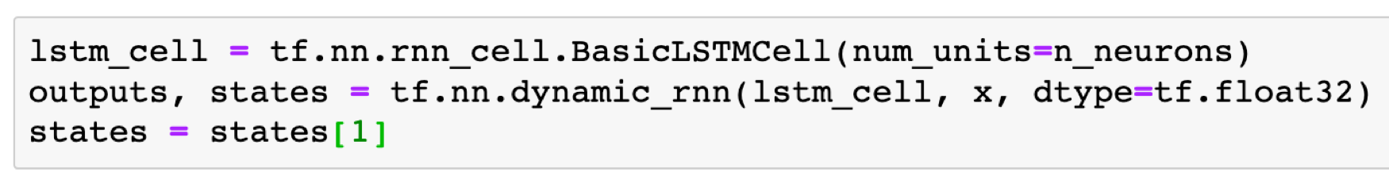
Previously
Now

Slide 21
Previously
Now

Slide 22
Previously
Now

Slide 23
Previously
Now

Slide 24
Previously
Now
Note

Slide 25
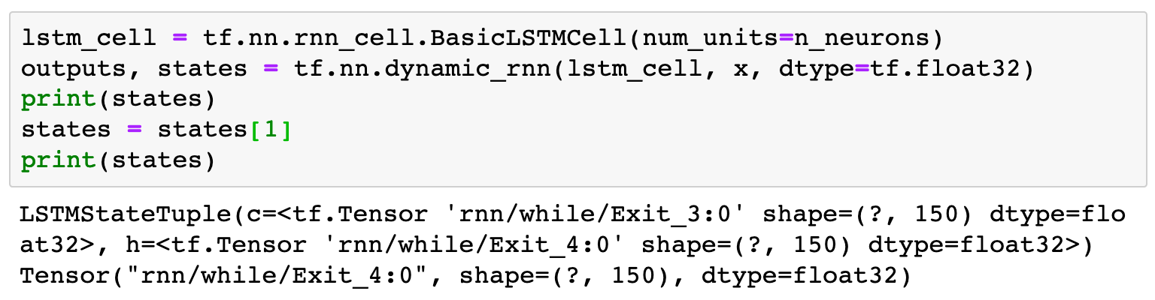

Slide 26
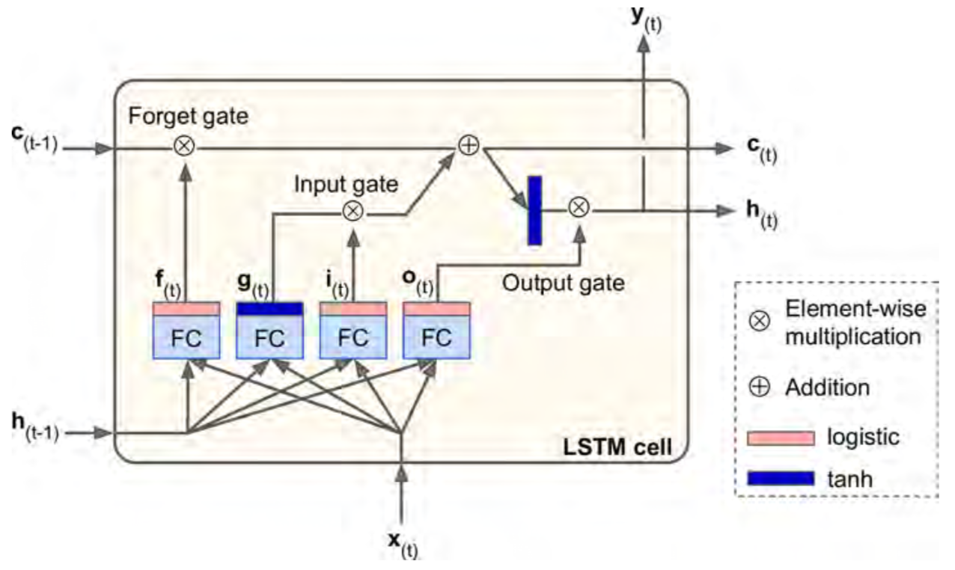
Chapter 14 (O'Reilly) of Hands-On ML

Slide 27
Chapter 14 (O'Reilly) of Hands-On ML
states[0]

Slide 28
Chapter 14 (O'Reilly) of Hands-On ML
states[0]
states[1]

Slide 29
Chapter 14 (O'Reilly) of Hands-On ML

Slide 30
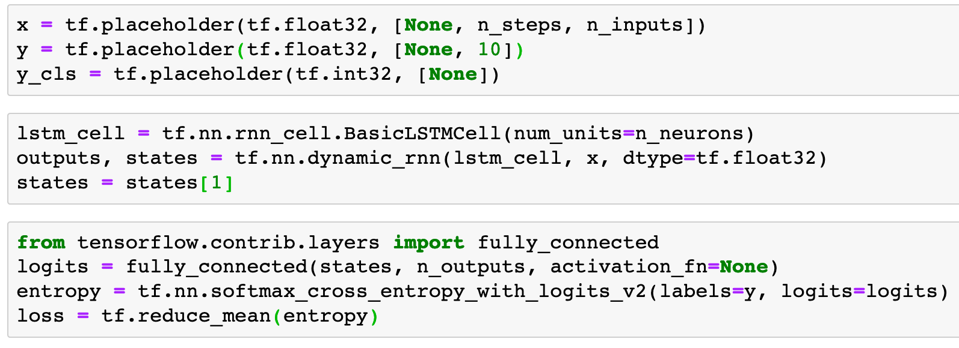

Chapter 14 (O'Reilly) of Hands-On ML

Slide 31
Chapter 14 (O'Reilly) of Hands-On ML
x

Slide 32
Chapter 14 (O'Reilly) of Hands-On ML
(?,28,28)
x

Slide 33
Chapter 14 (O'Reilly) of Hands-On ML
(?,28,28)
x

Slide 34
Chapter 14 (O'Reilly) of Hands-On ML
states
(?,28,28)
x

Slide 35
Chapter 14 (O'Reilly) of Hands-On ML
states
(?,150)
(?,28,28)
x

Slide 36
Chapter 14 (O'Reilly) of Hands-On ML
states
(?,150)
(?,28,28)
x

Slide 37
Chapter 14 (O'Reilly) of Hands-On ML
logits
states
(?,150)
x

Slide 38
Chapter 14 (O'Reilly) of Hands-On ML
(?,10)
logits
states
(?,150)
x

Slide 39
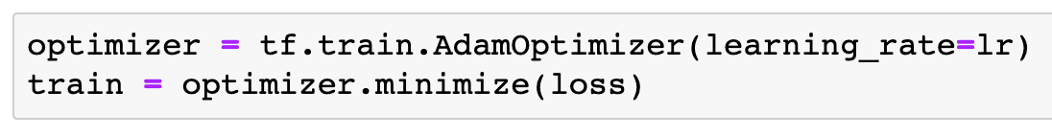

Slide 40
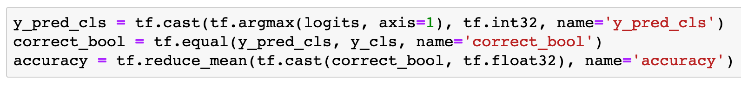

Slide 41
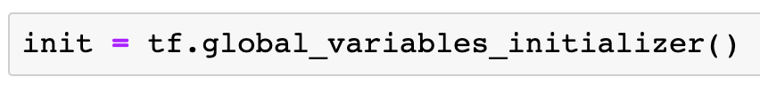

Slide 42
Session

Slide 43
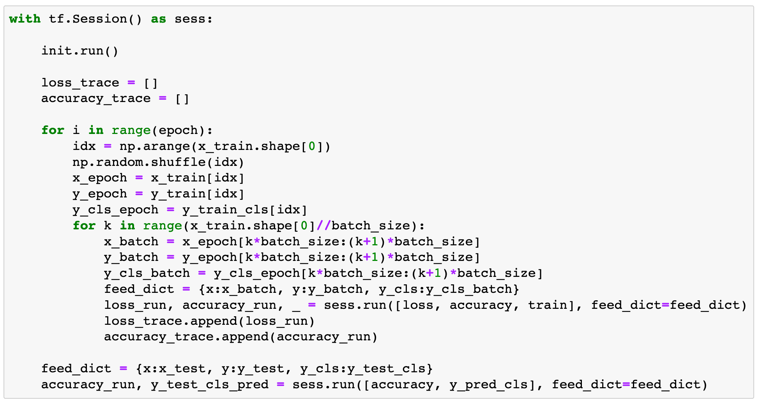

Slide 44
Report Result

Slide 45
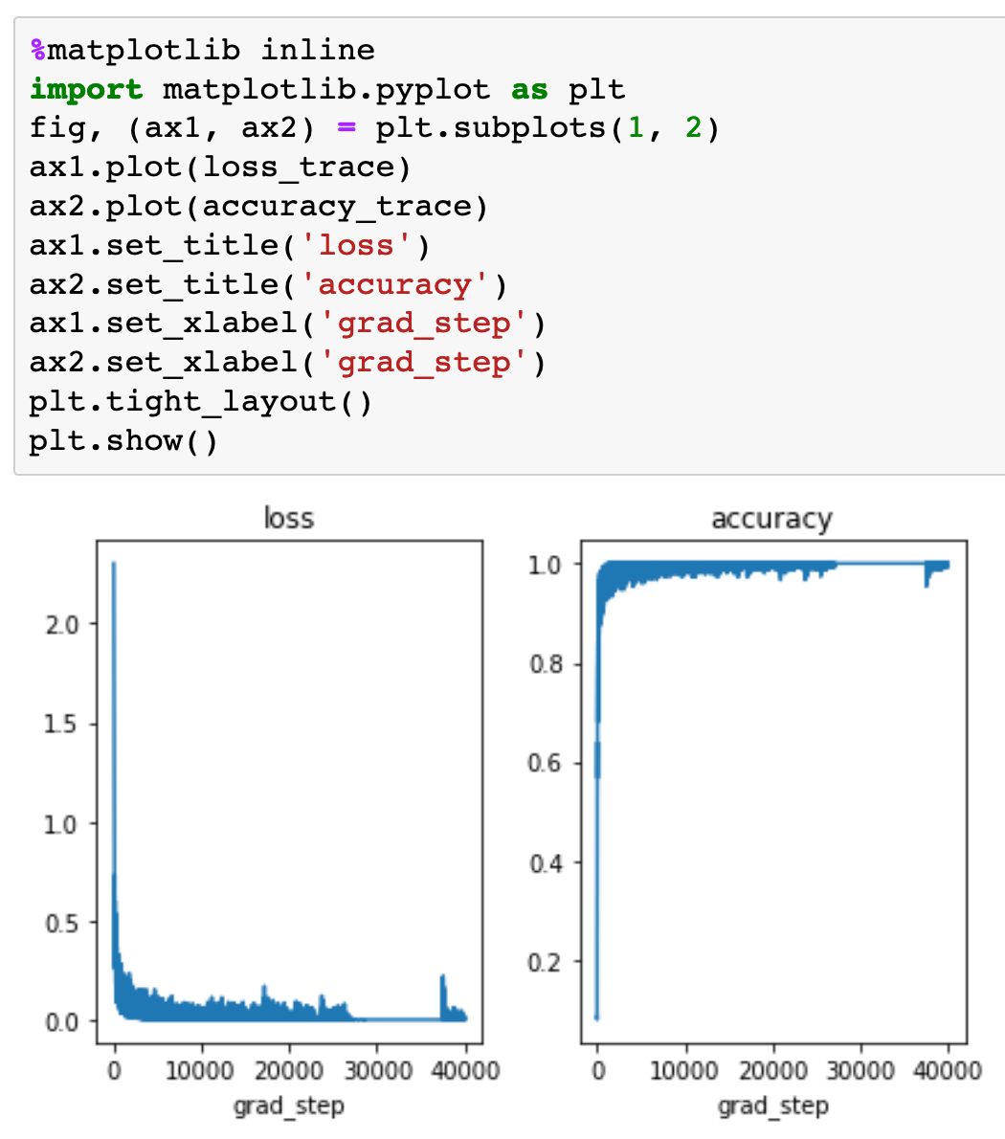

Slide 46
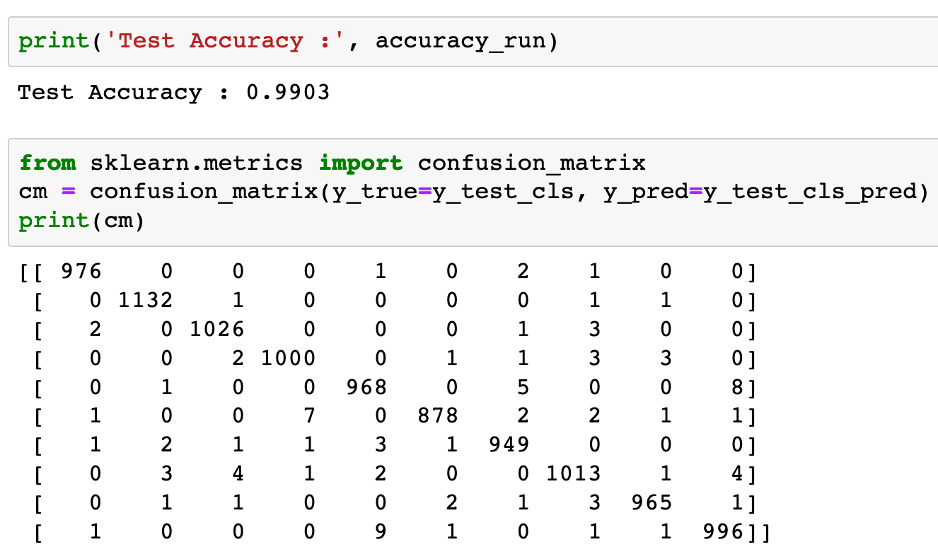


Slide 48
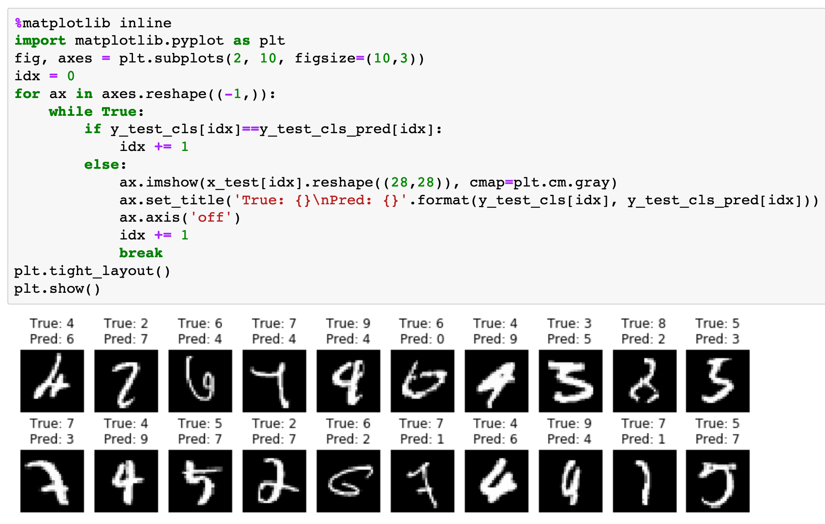

Slide 49
Now
Let’s Play with Code

